Slide 1
Distributed and Cloud Operating Systems

Slide 2
Key Concepts
A Distributed Operating System (DOS) manages a collection of independent computers and makes them appear to users as a single unified system. The computers (called nodes) are connected through a network and cooperate to share resources such as processors, memory, files, and devices.
The main goals of a distributed OS include:
  Resource sharing
  High performance through parallelism
  Reliability and fault tolerance
  Scalability
  Transparency to users
Three fundamental concepts in distributed OS architecture are
Transparency
Communication
Synchronization.

Slide 3
Transparency
Transparency in a distributed operating system means hiding the complexity of the distributed system from users and applications so that the system appears as a single coherent system.
The user does not need to know:
  Where resources are located
  How communication occurs
  Whether processes run locally or remotely

Slide 4
Types of Transparency
1. Access Transparency
Users access local and remote resources in the same way.
Example
Opening a file on another machine should be the same as opening a local file.
Example command:
open("data.txt")
The OS decides whether the file is local or remote.
2. Location Transparency
Users do not need to know where the resource is physically located.
Example
A printer may be in another building, but users print without specifying its location.
print document.pdf
The system automatically routes the job.

Slide 5
Transparency: Types of Transparency
3. Migration Transparency
Resources or processes may move from one node to another without affecting users or applications.
Example
A running process may move to another server for load balancing.
4. Replication Transparency
Multiple copies of resources may exist to improve reliability and performance.
Example
A distributed file system may maintain multiple copies of a file on different servers.
Users still access it as:
/home/data/report.txt
without knowing which copy is used.

Slide 6
Types of Transparency
5. Concurrency Transparency
Multiple users can access shared resources simultaneously without interference.
Example
Many users can read the same database at the same time.
6. Failure Transparency
System continues operating even if some nodes fail.
Example
If a server crashes, another replica automatically serves the data.
Importance of Transparency
Benefits include:
Simplifies system usage
Improves reliability
Enhances system flexibility
Hides network complexity

Slide 7
Communication
In a distributed operating system, processes running on different machines must exchange information to cooperate. This is called interprocess communication (IPC).
Since processes are on different machines, communication occurs through the network.

Slide 8
Communication
1. Message Passing
Processes communicate by sending and receiving messages.
Basic operations:
send(destination, message)
receive(source, message)
Example
Process A sends data to Process B.
send(B, "data")
receive(A, msg)
Advantages:
Simple and flexible
Works well in distributed systems
Disadvantages:
Communication overhead

Slide 9
Communication
Remote Procedure Call (RPC)
RPC allows a program to execute a procedure on another machine as if it were local.
Example
result = add(5,3)
The function may actually execute on a remote server.
RPC mechanism:
Client calls procedure
Client stub packages parameters
Message sent over network
Server stub unpacks parameters
Procedure executed
Result returned
Advantages:
Simplifies distributed programming
Similar to normal function calls

Slide 10
Communication
Remote Method Invocation (RMI)
Used in object-oriented systems.
Allows invoking methods of objects located on remote machines.
Example (Java RMI):
remoteObject.calculate()

Slide 11
Communication
Socket Communication
Low-level communication mechanism using network sockets.
Example (Client-Server):
Client connects to server using:
socket()
connect()
send()
receive()
Example applications:
Web servers
Chat systems
Distributed databases

Slide 12
Synchronization
Synchronization ensures that multiple processes in a distributed system coordinate their execution correctly when accessing shared resources.
Without synchronization:
  Race conditions occur
  Data inconsistency happens

Slide 13
Synchronization
Need for Synchronization
Example problem
  Two processes updating a shared bank balance.
  Initial balance = 100
  Process A:
  balance = balance + 50
  Process B:
  balance = balance - 30
If executed concurrently without synchronization, the final value may be incorrect.
Synchronization Issues in Distributed Systems
Synchronization is harder because:
  No shared memory
  No global clock
  Network delays
  Partial failures

Slide 14
Synchronization Techniques
1. Distributed Mutual Exclusion
Ensures only one process accesses a critical section at a time.
Approaches include:
Token-based algorithms
Permission-based algorithms
Example algorithms:
Ricart–Agrawala Algorithm
Token Ring Algorithm

Slide 15
Synchronization Techniques
2. Logical Clocks
Since distributed systems lack a global clock, logical clocks order events.
Lamport Clock concept:
Each process maintains a logical counter.
Rules:
Increment counter before each event
Send timestamp with message
Receiver updates clock
Used for:
Event ordering
Consistency
3. Vector Clocks
Improvement over Lamport clocks.
Each process maintains a vector of counters to track causality between events.

Slide 16
Synchronization Techniques
4. Distributed Deadlock Handling
Deadlocks occur when processes wait indefinitely for resources.
Solutions:
Deadlock prevention
Deadlock avoidance
Deadlock detection
Example: Synchronization in Distributed Database
Suppose multiple users update the same record.
Synchronization mechanisms include:
Locking
Timestamp ordering
Two-phase commit protocol

Slide 17
Cloud Resource Management
Resource Management in cloud computing is the process of allocating, monitoring, optimizing, and releasing cloud resources so that applications run efficiently, cost is minimized, and performance requirements are met.
Cloud Resources Include: Compute (CPU, Virtual Machines, Containers), Memory (RAM), Storage and Network (Bandwidth, IPs, Load balancers)
Without proper resource management servers crash, slow response and money is wasted.

Slide 18
Cloud Resource Management
Cloud resource management includes:
Resource Provisioning
  Allocating resources when needed.
  Example: Launching a new VM when traffic increases
Resource Scheduling
  Deciding which task runs on which resource
  Similar to CPU scheduling in OS, but at cloud scale
Resource Monitoring
  Tracking usage of: CPU, Memory and Network traffic
Resource Optimization
  Remove idle VMs
  Resize over-provisioned machines
Resource Deallocation
  Release unused resources to save cost

Slide 19
Resource Scaling in Cloud
Scaling is the ability of a cloud system to increase or decrease resources based on demand.
Scaling = Adjusting system size according to traffic
When traffic is not constant the resources need to managed to attend all the requests in optimized way.
Scaling can be done manually or automatic;
  In manual scaling, User manually adds/removes resources
  In auto-scaling system performs scaling based on some trigger metrices such as CPU use > 70% or requests/sec.

Slide 20
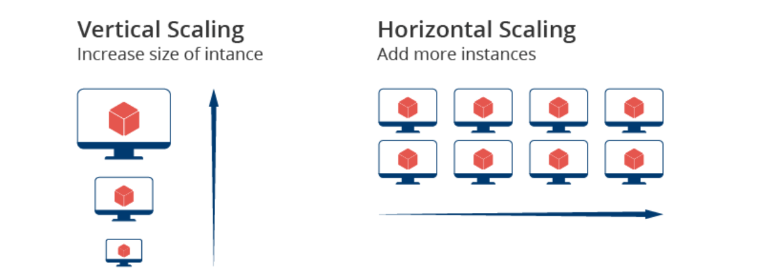
Types of Cloud Scaling
Vertical Scaling: Increasing resources of one machine
  Example: RAM: 4GB → 8GB or CPU 2 cores → 4 cores
  Advantages: Simple, No code changes
  Disadvantages: Hardware limit, Downtime required, Single point of failure
Horizontal Scaling: Adding or removing multiple machines
  Example: 1 server → 5 servers
  Advantages: High availability, Fault tolerance, No single point of failure
  Disadvantages: More complex, Requires load balancer

Slide 21
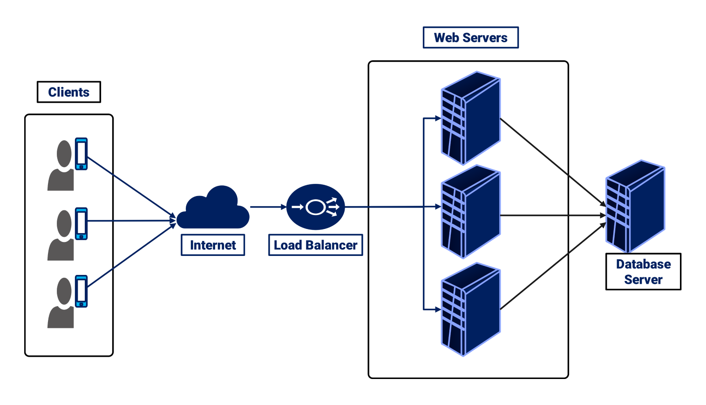
Load Balancing
Load Balancing is the process of distributing incoming traffic across multiple servers to avoid overload.
Load balancer enables horizontal scaling and prevents server overload, improves response time, ensures high availability.

Slide 22
Load Balancing Algorithms
Load balancing algorithms can be categorized in two types:
Static Load Balancing: predetermined assignment of tasks or resources without considering real-time variations in the system.
  This approach relies on a fixed allocation of workloads to servers or resources, and it doesn’t adapt to changes during runtime.
  Round Robin
  Weighted Round Robin
  Source IP hash
Dynamic Load Balancing: involves making real-time decisions about how to distribute incoming network traffic or computational workload across multiple servers or resources.
  This approach adapts to the changing conditions of the system, such as variations in server load, network traffic, or resource availability.
  Least Connection Method
  Least Response Time Method

Slide 23
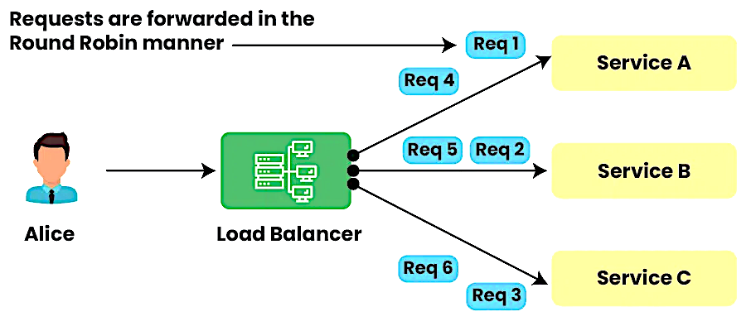
Load Balancing Algorithms
Round Robin
Requests are distributed across the servers in a sequential or rotational manner.
It is easy to implement but it doesn’t consider the load already on a server so there is a risk that one of the servers receives a lot of requests and becomes overloaded.

Slide 24
Load Balancing Algorithms
Weighted Round Robin
Each of the resources in a list is provided a weighted score.
Depending on the weighted score the request is distributed to these servers.
Servers with higher weights are given a larger proportion of the requests.
The distribution is cyclic, similar to the round-robin technique, but with each server receiving a number of requests proportional to its weight.
If a server reaches its processing capacity, it may start rejecting or queuing additional requests, depending on the server's specific behavior.
When to use Weighted Round Robin Load Balancing Algorithm?
  When servers have different capacities or performance levels.
  Ideal for environments where servers vary in resources (CPU, memory, etc.).

Slide 25
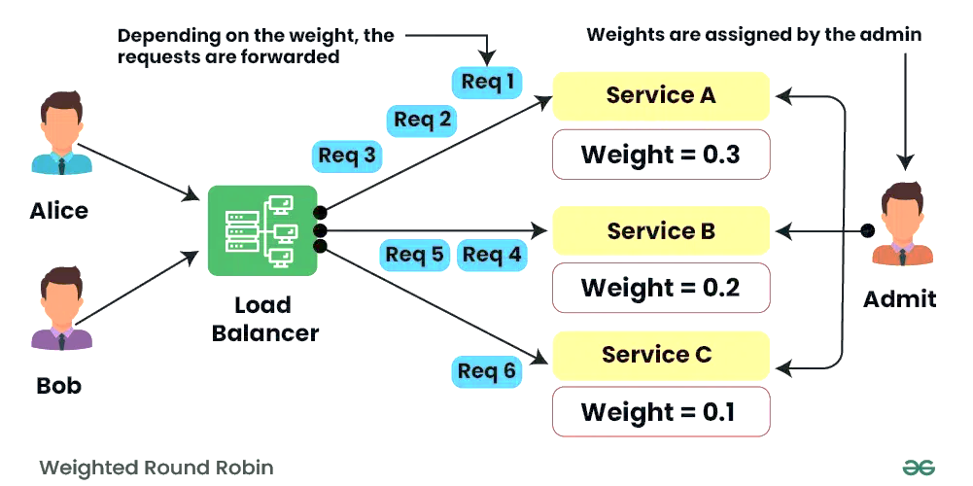
Load Balancing Algorithms
Weighted Round Robin
Let's say you have three servers with weights: Server1 (weight 0.3), Server2 (weight 0.2), and Server3 (weight 0.1). The total weight is 0.3 + 0.2 + 0.1 = 0.6.
During each cycle, Server1 would receive 0.3/0.6 (50%) of the requests, Server2 would receive 0.2/0.6 (33.33%), and Server3 would receive 0.1/0.6 (16.67%).

Slide 26
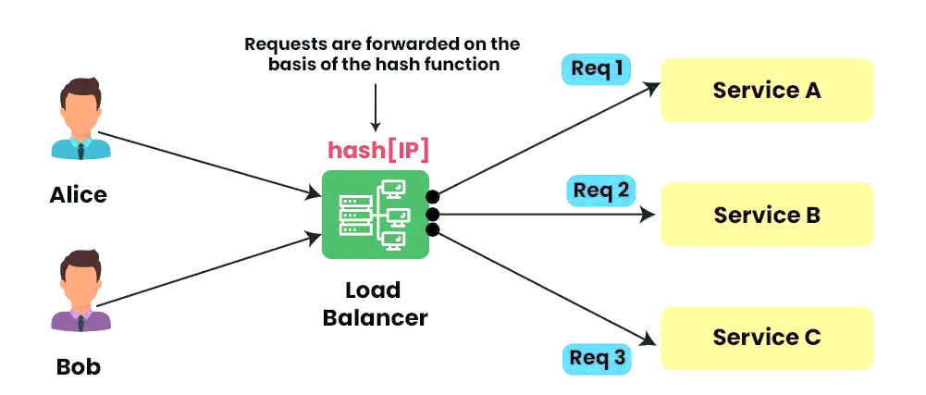
Load Balancing Algorithms
Source IP Hash
Incoming requests among a set of servers are distributed based on the hash value of the source IP address.
This algorithm aims to ensure that requests originating from the same source IP address are consistently directed to the same server.
This is beneficial for applications that require maintaining session information or state.

Slide 27
Load Balancing Algorithms
Least Connection Method
Assigns new requests to the server with the fewest active connections.
The idea is to distribute incoming workloads in a way that minimizes the current load on each server, aiming for a balanced distribution of connections across all available resources.
Load balancer needs to do some additional computing to identify the server with the least number of connections and the evaluation is based on the current load on the server.
Ideal for applications where some requests take longer to process than others (e.g., video streaming or large file uploads).
Useful when some connections stay active longer, as it ensures new requests go to servers with fewer active connections.

Slide 28
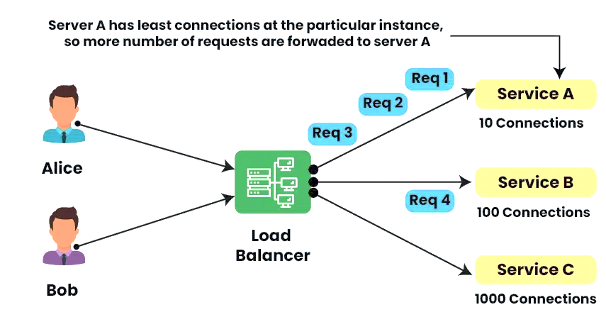
Load Balancing Algorithms
Least Connection Method
Benefits:
  Balanced Load: Distributes traffic to servers with the fewest active connections.
  Dynamic: Adapts to changing server workloads.
Drawbacks:
  Ignored Capacities: Ignores server capacities; a server with fewer connections may still have less capacity.
  Sticky Sessions: May not be suitable for scenarios requiring session persistence.

Slide 29
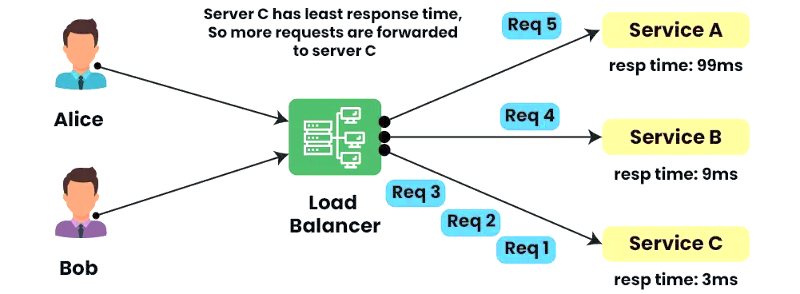
Load Balancing Algorithms
Least Response Time Method
Directs new requests to the server with the quickest response time.
It considers the historical performance of servers to make decisions about where to route incoming requests, optimizing for faster processing.
The dynamic aspect comes from the continuous monitoring of server response times and the adaptive nature of the algorithm to route incoming requests to the server with the historically lowest response time.

Slide 30
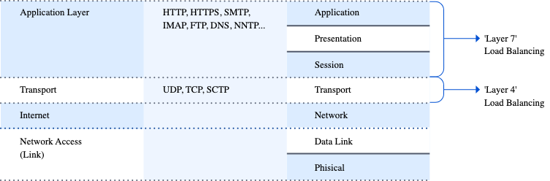
Layer 4 Load Balancer vs Layer 7 Load Balancer
Load balancers operate at different layers of the OSI model
  A Layer 4 load balancer forwards traffic based on: IP address, Port number, TCP/UDP session. It does not inspect application data.
  Layer 4 load balancer is blind to content. It only sees where the packet comes from and where it goes.
  A Layer 7 load balancer understands application protocols like HTTP / HTTPS, REST APIs, WebSockets and it can make decisions based on content.
  Layer 7 load balancer understands what the request is asking for. So suitable for Content-Based Routing, URL-Based Routing, Cookie-Based Routing, etc
https://freeloadbalancer.com/load-balancing-layer-4-and-layer-7
https://www.youtube.com/watch?v=aKMLgFVxZYk

Slide 31
Resource Management in Cloud Environments
Resource Management in Cloud Environments refers to the process of allocating, scheduling, monitoring, and optimizing computing resources in a cloud infrastructure. Cloud resources include computing power, storage, memory, network bandwidth, and applications that are delivered over the internet.
In cloud computing, resources are shared among many users (multi-tenancy). Therefore, efficient resource management is essential to ensure:
High performance
Efficient utilization of resources
Scalability
Cost effectiveness
Service reliability
Cloud service providers such as Amazon Web Services, Microsoft Azure, and Google Cloud Platform use advanced resource management mechanisms to dynamically distribute resources among users.

Slide 32
Objectives of Resource Management
1. Efficient Resource Utilization
Cloud resources should be used efficiently so that idle resources are minimized.
Example:
A server with 64 GB RAM should not remain unused while other servers are overloaded.
2. Scalability
The system should easily increase or decrease resources depending on demand.
Example:
During festivals, an e-commerce website may require more servers.
During normal days, fewer servers are sufficient.

Slide 33
Objectives of Resource Management
3. Quality of Service (QoS)
Cloud providers must meet performance guarantees such as:
Response time
Availability
Throughput
Reliability
4. Cost Optimization
Users should only pay for the resources they use (Pay-as-you-go model).
Example:
If a virtual machine runs for 3 hours, the user only pays for 3 hours.
5. Load Balancing
Workloads should be evenly distributed among available resources to prevent overload.

Slide 34
Types of Cloud Resources
3.1 Compute Resources
These are processing resources such as:
CPUs
GPUs
Virtual machines
Containers
Example:
A user may launch a virtual machine instance to run applications.
Compute resources are often managed using virtualization technologies such as:
VMware
KVM (Kernel-based Virtual Machine)
Docker

Slide 35
Types of Cloud Resources
3.2 Storage Resources
Cloud platforms provide various storage systems such as:
Object storage
Block storage
File storage
Examples include services like:
Amazon S3
Google Cloud Storage
Resource management ensures that storage is:
Reliable
Redundant
Scalable

Slide 36
Types of Cloud Resources
3.3 Network Resources
Network resources include:
Bandwidth
Load balancers
Routers
Firewalls
Efficient network resource management ensures:
Low latency
High data transfer speed
Secure communication

Slide 37
Key Components of Cloud Resource Management
4.1 Resource Provisioning
Resource provisioning refers to the process of allocating resources to users when requested.
Example:
A user requests a virtual machine with:
4 CPU cores
8 GB RAM
100 GB storage
The cloud system automatically allocates these resources.
Provisioning can be:
Static provisioning – resources allocated manually.
Dynamic provisioning – resources allocated automatically.

Slide 38
Key Components of Cloud Resource Management
4.2 Resource Scheduling
Resource scheduling determines when and where tasks should be executed.
Goals:
Minimize execution time
Maximize resource utilization
Reduce cost
Example scheduling algorithms:
First Come First Serve (FCFS)
Round Robin
Priority Scheduling
Cloud schedulers decide which server will execute a given workload.

Slide 39
Key Components of Cloud Resource Management
4.3 Resource Monitoring
Cloud providers continuously monitor resources such as:
CPU utilization
Memory usage
Disk I/O
Network traffic
Monitoring tools help detect:
System failures
Overloaded servers
Performance bottlenecks
Example monitoring services include:
Amazon CloudWatch
Prometheus

Slide 40
Key Components of Cloud Resource Management
4.4 Resource Allocation
Resource allocation ensures that resources are distributed efficiently among users.
Two approaches:
1. Static Allocation
Resources are fixed once allocated.
Example:
A server permanently assigned to one application.
2. Dynamic Allocation
Resources change depending on workload.
Example:
Auto-scaling servers based on traffic.

Slide 41
Key Components of Cloud Resource Management
4.5 Load Balancing
Load balancing distributes incoming workloads evenly across multiple servers.
Benefits:
Prevents server overload
Improves system performance
Enhances fault tolerance
Common load balancing techniques include:
Round Robin
Least Connection
Weighted distribution
Example tools:
NGINX
HAProxy

Slide 42
Virtualization in Resource Management
Virtualization creates virtual versions of physical resources such as servers, storage devices, and networks.
A single physical server can run multiple virtual machines (VMs).
Example:
One physical server may host:
VM1: Web server
VM2: Database server
VM3: Application server
Benefits:
Better resource utilization
Isolation between users
Easy scalability

Slide 43
Auto Scaling
Auto scaling automatically adjusts resources based on system demand.
Example:
A website receives heavy traffic during peak hours.
The system automatically:
Adds more virtual machines
Distributes traffic among them
When traffic decreases:
Extra servers are removed.
This improves both performance and cost efficiency.

Slide 44
Challenges in Cloud Resource Management
Managing resources in cloud environments is complex due to several challenges.
1. Resource Heterogeneity
Cloud data centers contain different types of hardware and software systems.
2. Dynamic Workloads
User demand changes continuously, making resource prediction difficult.
3. Energy Consumption
Large data centers consume significant electricity.
Energy-efficient resource allocation is necessary.
4. Security and Isolation
Multiple users share the same physical infrastructure.
Proper isolation must be maintained to ensure security.
5. Fault Tolerance
Hardware failures, network issues, or software bugs can affect services.
Cloud systems must recover quickly from failures.

Slide 45
Resource Management Techniques
Several techniques are used to improve resource management in cloud environments.
1. Virtual Machine Migration
VMs can be moved from one physical server to another without stopping execution.
Benefits:
Load balancing
Hardware maintenance
Fault tolerance

Slide 46
Resource Management Techniques
2. Containerization
Containers provide lightweight virtualization.
Example platform:
Kubernetes manages container orchestration.
Advantages:
  Faster deployment
  Better scalability
  Lower overhead

Slide 47
Resource Management Techniques
3. Energy-Aware Scheduling
Scheduling algorithms try to minimize power consumption by:
Consolidating workloads
Turning off idle servers

Slide 48
Cloud Operating Systems: Kubernetes
Kubernetes is an open-source container orchestration platform originally developed by Google and later maintained by the Cloud Native Computing Foundation. It automates the deployment, scaling, and management of containerized applications.
Containers package applications along with their dependencies so they can run consistently across different environments. Kubernetes manages these containers efficiently across clusters of machines.
Kubernetes is widely used in modern cloud-native architectures and works well with container technologies such as Docker.

Slide 49
Example of Cloud Resource Management
Consider a video streaming platform hosted in the cloud.
Steps in resource management:
  Users request videos.
  Load balancer distributes requests.
  Cloud scheduler assigns tasks to servers.
  Auto scaling adds servers when traffic increases.
  Monitoring tools track system performance.
  This ensures smooth streaming even with millions of users.

Slide 50
Architecture of Kubernetes
Kubernetes operates using a cluster architecture consisting of two main components:
1. Control Plane (Master Node)
The control plane manages the overall cluster operations.
Main components include:
API Server
Acts as the front-end of the Kubernetes control plane and handles all administrative commands.
Scheduler
Assigns newly created containers to appropriate nodes based on resource availability.
Controller Manager
Maintains the desired system state and monitors cluster activities.
etcd
A distributed key-value database used to store cluster configuration and state information.

Slide 51
Architecture of Kubernetes
2. Worker Nodes
Worker nodes run the actual application containers.
Each worker node contains:
Kubelet
Agent that communicates with the control plane and manages containers.
Container Runtime
Software responsible for running containers such as Docker.
Kube-proxy
Handles networking and load balancing between containers.

Slide 52
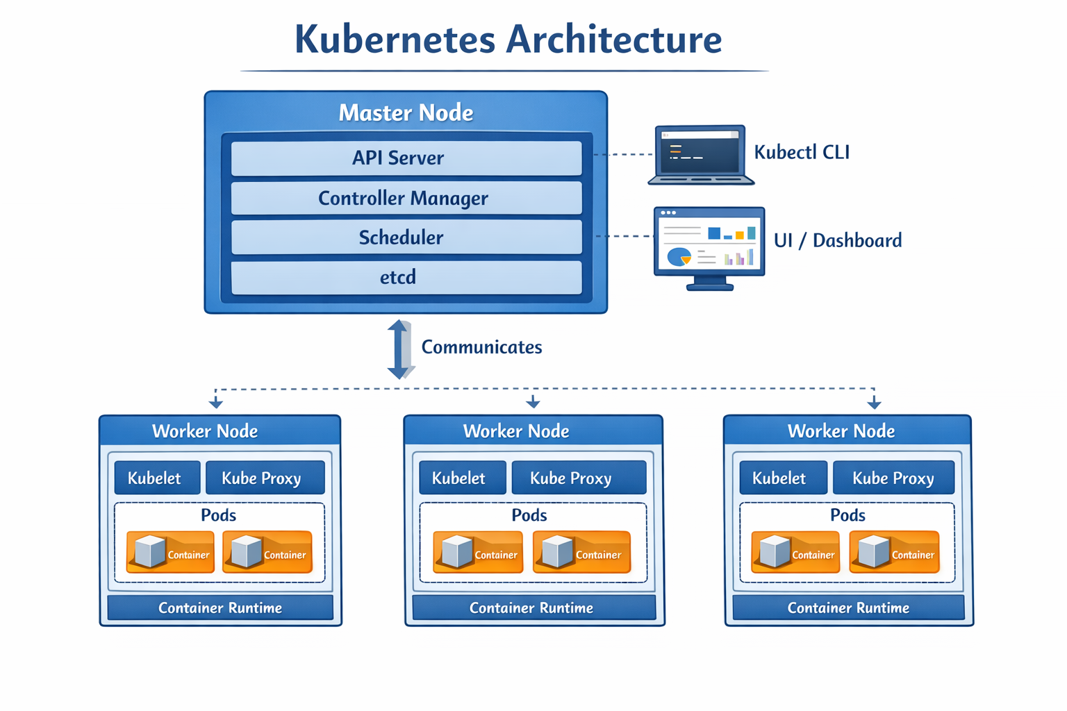

Slide 53
Key Features of Kubernetes
1. Container Orchestration
Kubernetes automates container deployment and management across multiple servers.
2. Auto Scaling
Kubernetes automatically increases or decreases containers depending on workload.
Example:
If web traffic increases, additional containers are created automatically.
3. Self-Healing
If a container fails, Kubernetes automatically restarts or replaces it.
This improves system reliability.
4. Load Balancing
Kubernetes distributes network traffic evenly across containers to maintain performance.
5. Rolling Updates and Rollbacks
Applications can be updated without downtime. If an update fails, Kubernetes can roll back to a previous version.

Slide 54
Kubernetes pros and cons
Advantages of Kubernetes
  High scalability
  Automated container management
  Efficient resource utilization
  Improved reliability
  Supports microservices architecture
Limitations of Kubernetes
  Complex setup and configuration
  Requires skilled administrators
  Networking configuration can be challenging

Slide 55
Cloud OS: OpenStack
OpenStack is an open-source cloud computing platform used for building and managing private and public cloud infrastructures. It provides a complete solution for managing computing, storage, and networking resources in large data centers.
OpenStack is commonly used to implement Infrastructure-as-a-Service (IaaS) clouds where users can create and manage virtual machines on demand.
It was initially developed through collaboration between Rackspace Technology and NASA.

Slide 56
Architecture of OpenStack
OpenStack consists of several independent services that work together to manage cloud infrastructure.
Major components include:
1. Nova (Compute Service)
Nova manages the lifecycle of virtual machines.
Functions include:
Creating virtual machines
Scheduling workloads
Managing compute resources
2. Neutron (Networking Service)
Neutron provides networking services such as:
IP address management
Virtual networks
Routers and firewalls

Slide 57
Architecture of OpenStack
3. Cinder (Block Storage)
Cinder provides persistent block storage for virtual machines.
Example:
Attaching a virtual disk to a VM.
4. Swift (Object Storage)
Swift provides scalable object storage used for storing large amounts of unstructured data.
Example:
Backups
Images
Videos

Slide 58
Architecture of OpenStack
5. Glance (Image Service)
Glance stores and manages virtual machine images used to create new VMs.
6. Keystone (Identity Service)
Keystone provides authentication and authorization for OpenStack services.
7. Horizon (Dashboard)
Horizon provides a web-based graphical interface for managing cloud resources.

Slide 59
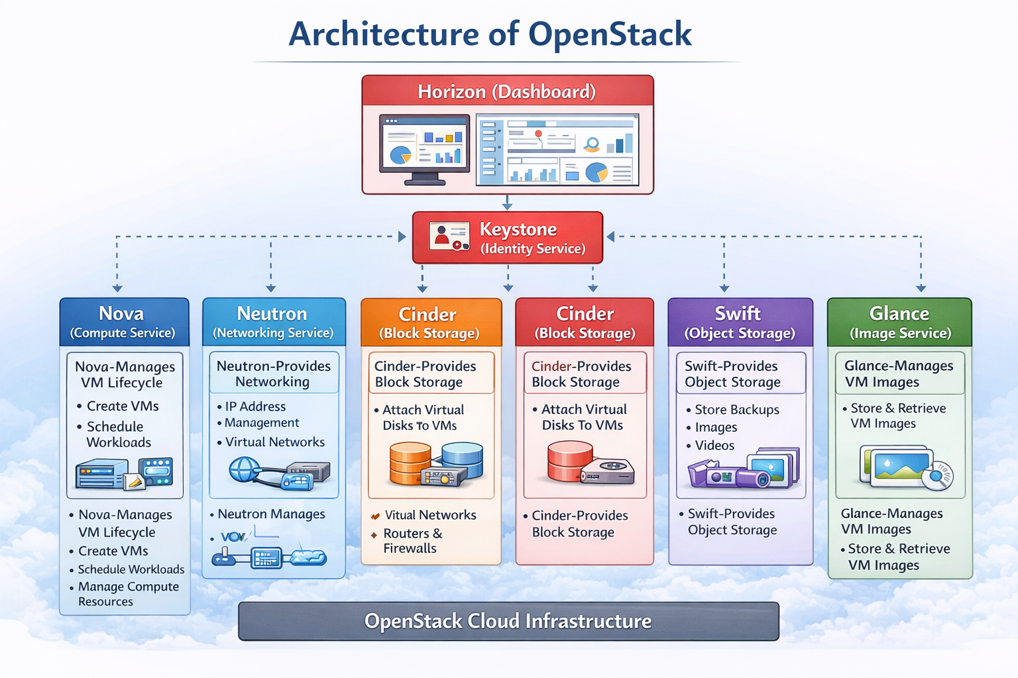

Slide 60
Key Features of OpenStack
1. Infrastructure Virtualization
OpenStack allows virtualization of computing resources in data centers.
2. Multi-Tenant Architecture
Multiple users or organizations can share the same infrastructure securely.
3. Scalability
OpenStack can manage thousands of servers and virtual machines.
4. Open Source Platform
Organizations can customize OpenStack according to their needs.
5. API-Based Architecture
All services communicate using APIs, enabling automation and integration with other systems.

Slide 61
OpenStack Pros and Cons
Advantages of OpenStack
Highly scalable
Flexible architecture
Open-source and customizable
Supports hybrid and private clouds
Limitations of OpenStack
Complex installation and maintenance
Requires significant infrastructure
High operational cost for small organizations

Slide 62
Case studies : Amazon DynamoDB (NoSQL), Microsoft Azure and Fault Tolerant DS.
Assignment
Make a video of 10 minutes presentation explaining DynamoDB (NoSQL) or Microsoft Azure or Fault Tolerant DS.
The video should be posted in youtube and link should be provided

